Slide 1
TOP 9 BEAUTIFUL PLACES IN THEWORLD
-BY BHARGAVI
GVPCEW

Slide 2
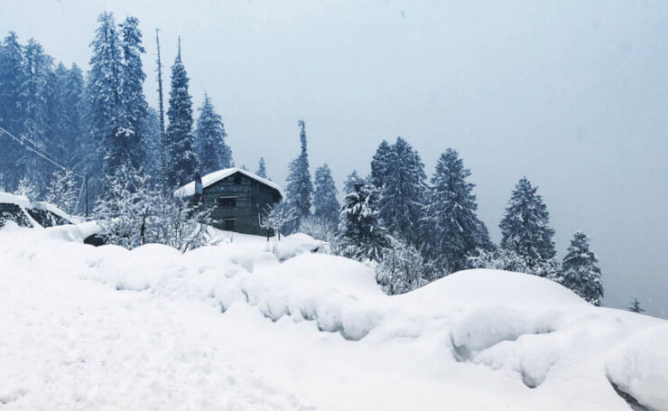

Slide 3
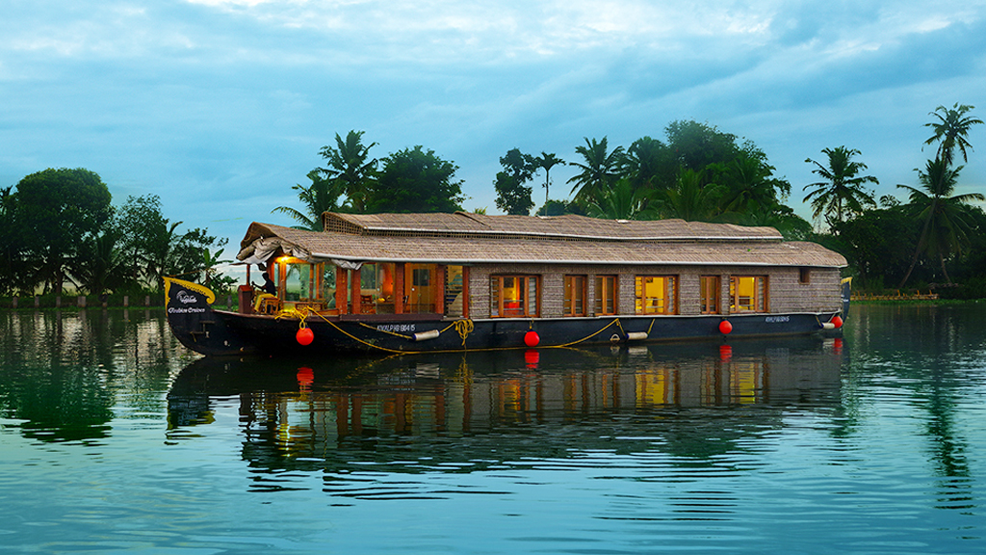

Slide 4
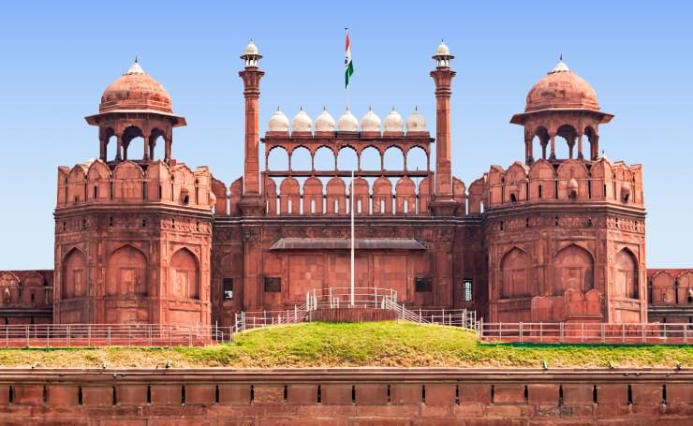

Slide 5
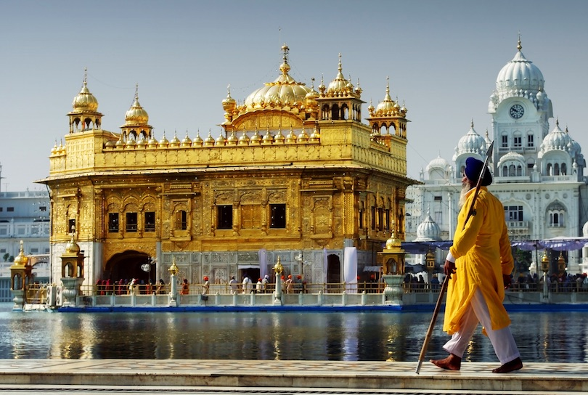

Slide 6
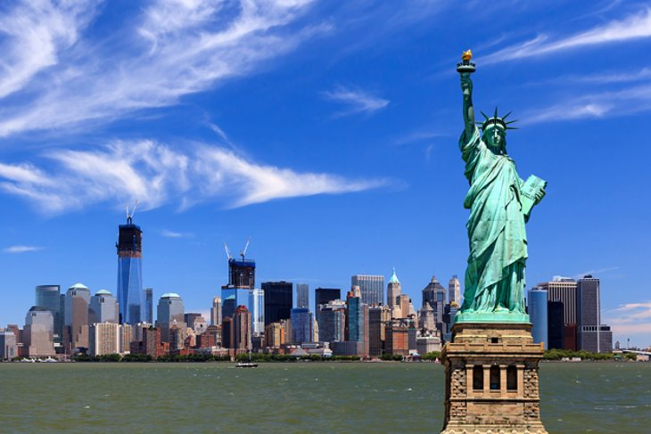

Slide 7
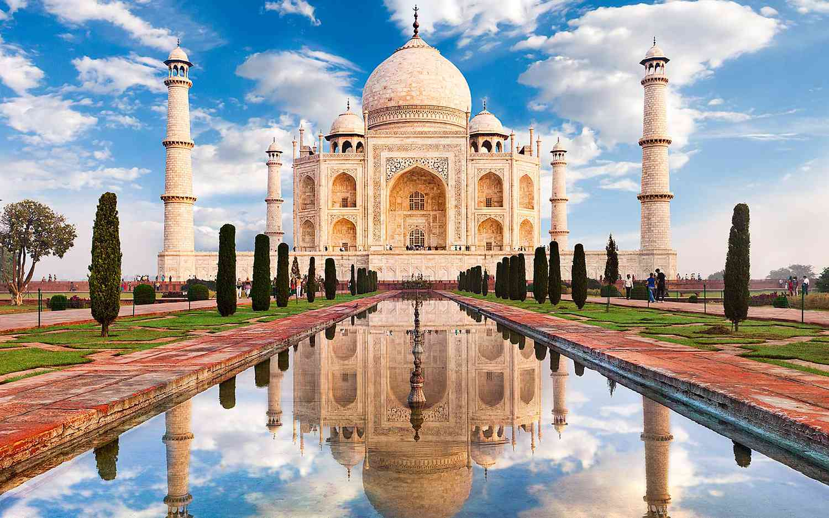

Slide 8
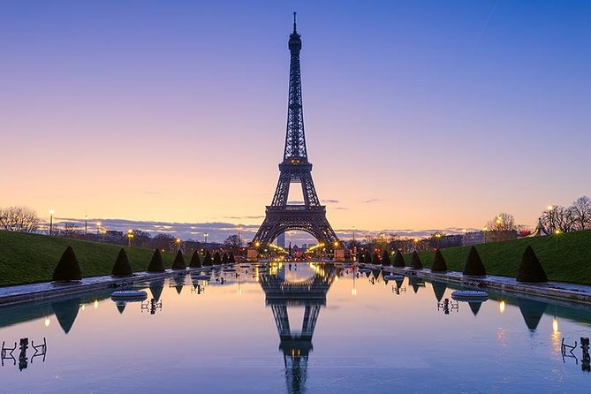

Slide 9
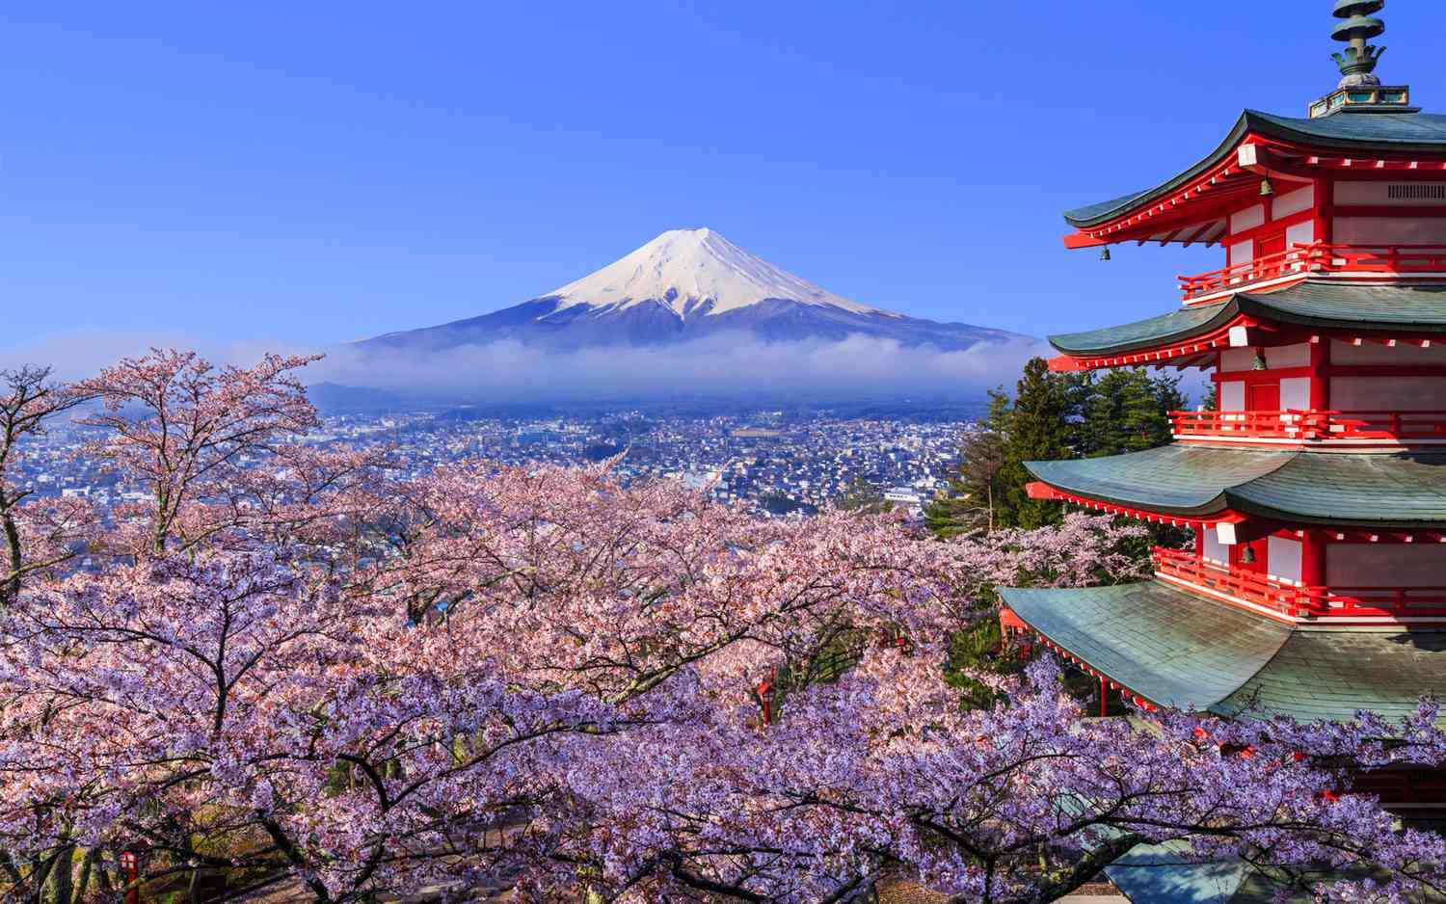

Slide 10
TOP 10 BEAUTIFUL PLACES IN WORLD

Slide 11
PHOTO ALBUM
_BY BHARGAVI
GVPCEW

